Slide 1
Game Design Merit Badge
Troop 344 and 9344
Pemberville, OH

Slide 2
Game Design Requirements
Do the following:
Analyze four games you have played, each from a different medium. Identify the medium, player format, objectives, rules, resources, and theme (if relevant). Discuss with your counselor the play experience, what you enjoy in each game, and what you dislike. Make a chart to compare and contrast the games.
Describe four types of play value and provide an example of a game built around each concept. Discuss other reasons people play games.

Slide 3
Game Design Requirements
Discuss with your counselor five of the following 17 game design terms. For each term that you pick, describe how it relates to a specific game.
Thematic game elements:
story,
setting,
characters
Gameplay elements:
play sequence,
level design,
interface design
Game analysis:
difficulty,
balance,
depth,
pace,
replay value,
age appropriateness
Related terms:
single-player vs. multiplayer,
cooperative vs. competitive,
turn-based vs. real-time,
strategy vs. reflex vs. chance,
abstract vs. thematic

Slide 4
Game Design Requirements
Define the term intellectual property. Describe the types of intellectual property associated with the game design industry. Describe how intellectual property is protected and why protection is necessary. Define and give an example of a licensed property.

Slide 5
Game Design Requirements
Do the following:
Pick a game where the players can change the rules or objectives (examples: basketball, hearts, chess, kickball). Briefly summarize the standard rules and objectives and play through the game normally.
Propose changes to several rules or objectives. Predict how each change will affect gameplay.
Play the game with one rule or objective change, observing how the players’ actions and emotional experiences are affected by the rule change. Repeat this process with two other changes.
Explain to your counselor how the changes affected the actions and experience of the players. Discuss the accuracy of your predictions.

Slide 6
Game Design Requirements
Design a new game. Any game medium or combination of mediums is acceptable. Record your work in a game design notebook.
Write a vision statement for your game. Identify the medium, player format, objectives, and theme of the game. If suitable, describe the setting, story, and characters.
Describe the play value.
Make a preliminary list of the rules of the game. Define the resources.
Draw the game elements.

Slide 7
Game Design Requirements
Do the following:
Prototype your game from requirement 5. If applicable, demonstrate to your counselor that you have addressed player safety through the rules and equipment. Record your work in your game design notebook.
Test your prototype with as many other people as you need to meet the player format. Compare the play experience to your descriptions from requirement 5b. Correct unclear rules, holes in the rules, dead ends, and obvious rule exploits. Change at least one rule, mechanic, or objective from your first version of the game, and describe why you are making the change. Play the game again. Record in your game design notebook whether or not your change had the expected effect.
Repeat 6b at least two more times and record the results in your game design notebook.

Slide 8
Game Design Requirements
Blind test your game. Do the following:
Write an instruction sheet that includes all of the information needed to play the game. Clearly describe how to set up the game, play the game, and end the game. List the game objectives.
Share your prototype from requirement 6a with a group of players that has not played it or witnessed a previous playtest. Provide them with your instruction sheet(s) and any physical components. Watch them play the game, but do not provide them with instruction. Record their feedback in your game design notebook.
Share your game design notebook with your counselor. Discuss the player reactions to your project and what you learned about the game design process. Based on your testing, determine what you like most about your game and suggest one or more changes.

Slide 9
Game Design Requirements
Do ONE of the following:
With your parent’s permission and your counselor’s approval, visit with a professional in the game development industry and ask him or her about his or her job and how it fits into the overall development process. Alternately, meet with a professional in game development education and discuss the skills he or she emphasizes in the classroom.
List three career opportunities in game development. Pick one and find out about the education, training, and experience required for the profession. Discuss this with your counselor. Explain why this profession might interest you.

Slide 10
Requirement 1a
Do the following:
Analyze four games you have played, each from a different medium. Identify the medium, player format, objectives, rules, resources, and theme (if relevant). Discuss with your counselor the play experience, what you enjoy in each game, and what you dislike. Make a chart to compare and contrast the games.
Describe four types of play value and provide an example of a game built around each concept. Discuss other reasons people play games.

Slide 11
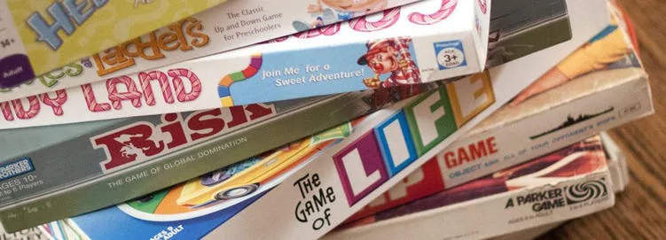
What is a Game?
Games are a form of play. Most games are played for recreation, others are played by amateurs and professionals alike, and some are even used as tools for training and education.
Games have objectives or goals that players work to achieve.
Games have rules. Rules govern the components of the game and the ways that players interact with those components and each other.
Games have feedback. As players work toward their goals, the game provides information about how they are doing. Scores are a form of feedback.

Slide 12
What is a Game?
Games have challenges. In the vast majority of games, the rules, other players, or other elements impede player progress toward the objectives.
Games employ a variety of skills. These include physical abilities, communication, strategic thinking, patience, observation and problem solving.
Games present choices. Players make meaningful decisions in order to affect game outcomes.
Games are participatory. Unlike many other forms of entertainment, games are not just about observing. They are about taking action.

Slide 13
Requirement 1a
Game Medium: Physical Games and Sports
Ball games and sports are physical as are other games like capture the flag.
These games involve athletic activities and are played with special equipment like balls, nets, or sticks
The gameplay usually revolves around one or more specific physical actions and the objectives reward players who most skillfully perform those actions.
Basketball is built around dribbling, passing, and shooting the ball.
The shape and details of the field of play are an important part of the game design.
Rules and objectives are often related to specific portions of the field.

Slide 14
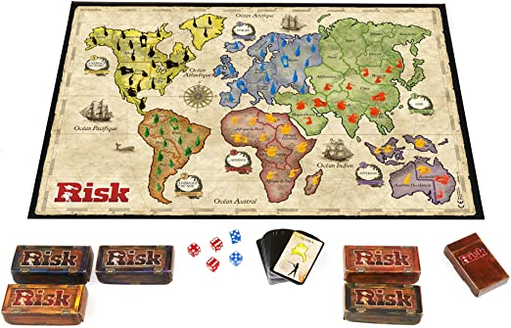
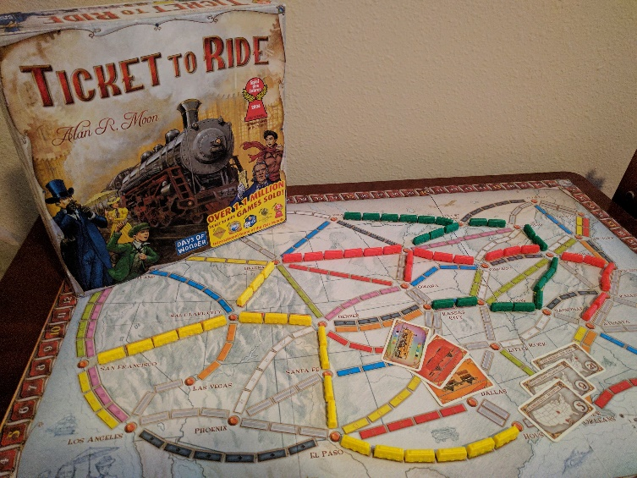
Requirement 1a
Game Medium: Board Games
Board games usually involve placing and moving pieces on a game board. They come in a variety of gameplay types:
Abstract games in which the board is divided into regular spaces and the players compete to claim pieces or spaces (checkers and chess).
Territorial strategy games like Risk where the board is a map with distributed resources and attributes.
Race-to-the-end games where players race along a linear track such as Candy Land.
Building games where players compete to reach construction objectives such as Ticket to Ride.

Slide 15
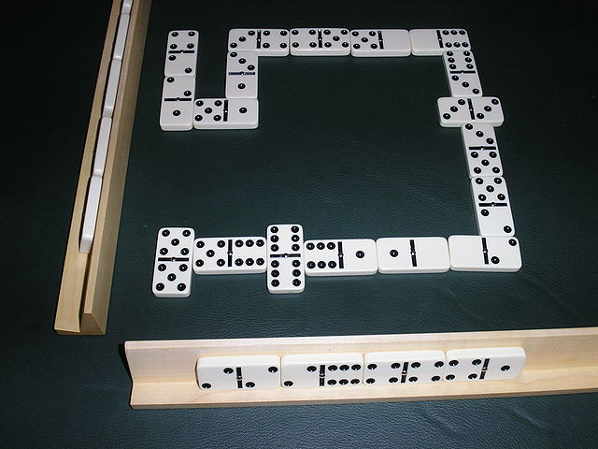
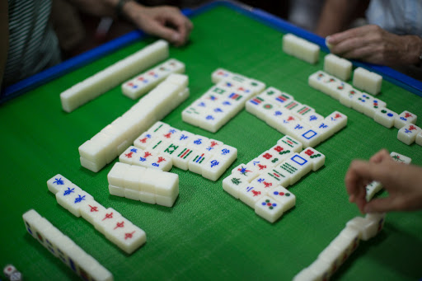
Requirement 1a
Game Medium: Tile Games
Tile Games are played with a limited set of tiles that may contain dots, letters, or special symbols.
Play consists of players placing one or more tiles from their hand adjacent to those already placed and then replenishing their hand with new tiles.
Scoring is usually performed when tiles are played.
Examples include dominoes and mahjong.

Slide 16
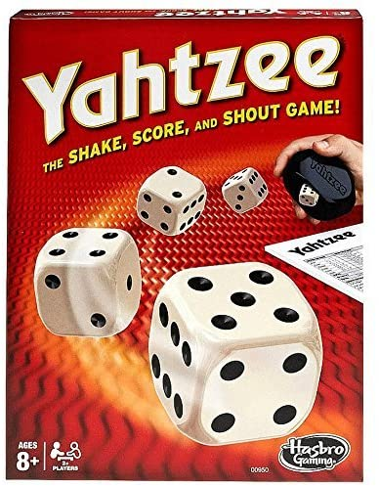
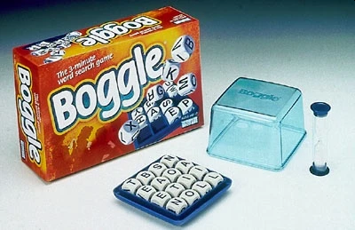
Requirement 1a
Game Medium: Dice Games
Dice Games are often used to introduce chance into games.
Some games, such as Yahtzee, use standard 6-dided dice.
Others, such as Boggle, replace the dots with letters or special symbols.
Dice games can usually be played by any number of players with the dice being passed from player to player.
A turn calls for the player to roll the dice.
Games are usually scored with the various combinations of dice having specific scoring.

Slide 17
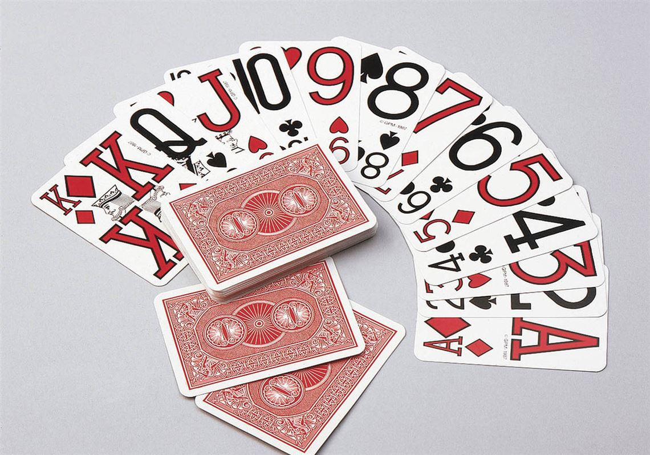
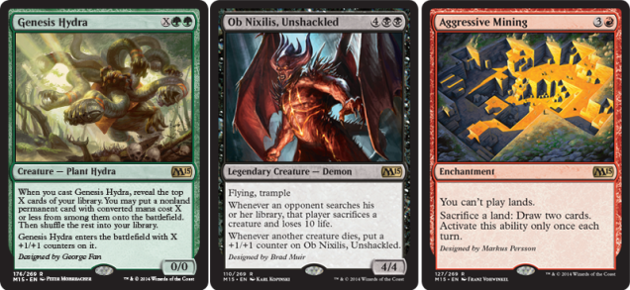
Requirement 1a
Game Medium: Card Games
Card Games are played with sets or “decks” of cards
Generally, the order of the deck is unknown.
Cards are mixed or shuffled at the beginning of the game.
Many card games use a standard playing card deck
Hearts, rummy, and euchre are examples.
Players build their own deck in collectible card games.
Magic or Pokémon are examples.

Slide 18
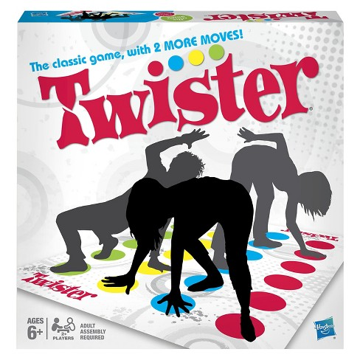
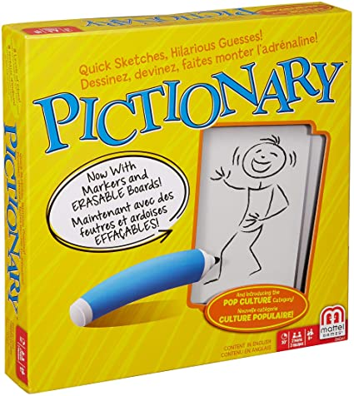
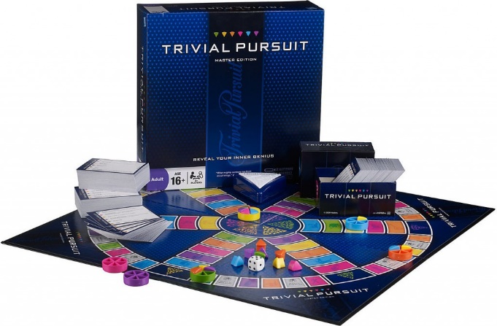
Requirement 1a
Game Medium: Party Games
Party Games are generally for 4 to 12 or more players often arranged in teams.
Gameplay emphasizes interactions between players and usually involves some form of creativity.
Drawing, acting, singing, giving word clues.
Trivia games also typically fall into this medium.
Party games place special emphasis on making the game fun for players and observers.
Examples include Twister, Trivial Pursuit, and Pictionary.

Slide 19
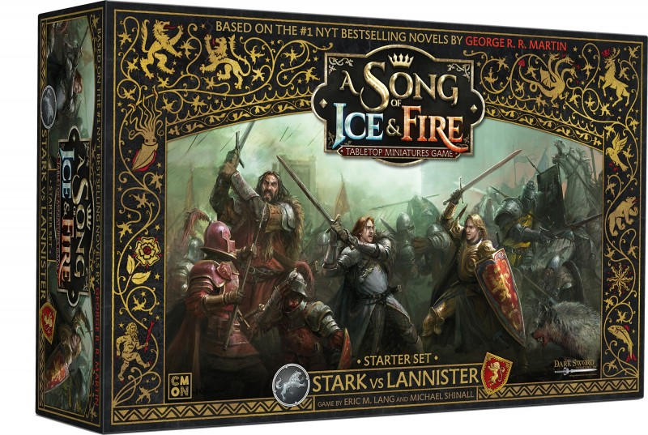
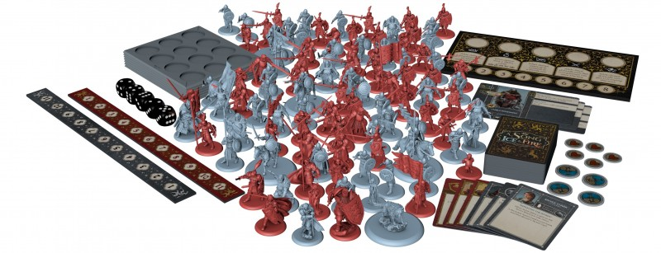
Requirement 1a
Game Medium: Miniatures
Games with miniatures are played with small, detailed models of pieces and terrain.
Settings include historical reenactments, fantasy, and science fiction.
Most miniature games are turn- based.
They are also commonly used in tabletop role-playing games to act out the action.

Slide 20
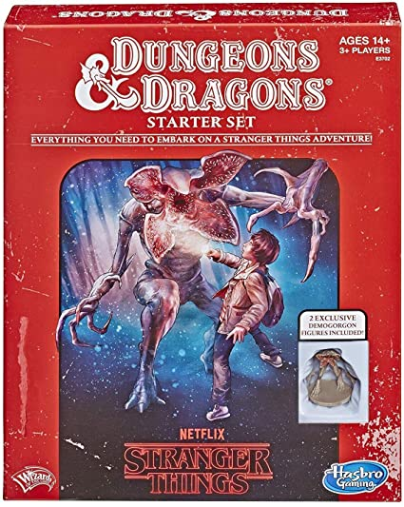
Requirement 1a
Game Medium: Role Playing Games
Text-Based Role Playing Games is most easily described as interactive storytelling.
A ruleset or system is used to define the gameplay, but the objectives may change during play.
Players take on the roles of distinct characters within a fictional setting and then take actions based on the capabilities of those characters.
These capabilities increase over time and allows players to take on progressively more challenging game scenarios.
The most well-known example is Dungeons and Dragons.

Slide 21
Requirement 1a
Game Medium: Electronic Games
Electronic Games are the largest growing game medium today.
Almost every other game type can be implemented in an electronic form.
Electronic games present information to players through video screens and audio signals.
Players interact with the games through electronic sensors, control pads, and computer mice.
Examples include World of Warcraft and Super Mario Bros.

Slide 22
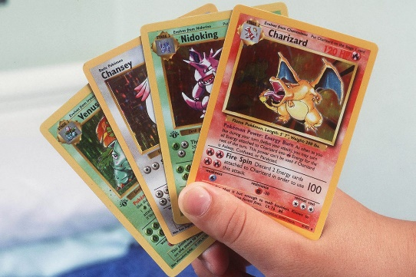
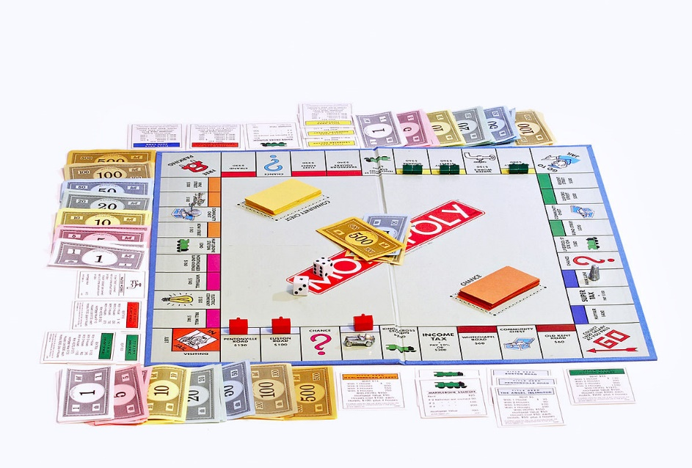
Requirement 1a
Game Medium
Gameplay is affected by medium, but is not completely constrained by medium.
Many games can be replicated in several different mediums
i.e. Electronic and card versions of Pokémon.
Mediums can be mixed together to utilize the advantages of each one.
Monopoly is a board game, but it also uses stacks of cards that can be mixed up and dice that add an element of chance to player movement.

Slide 23
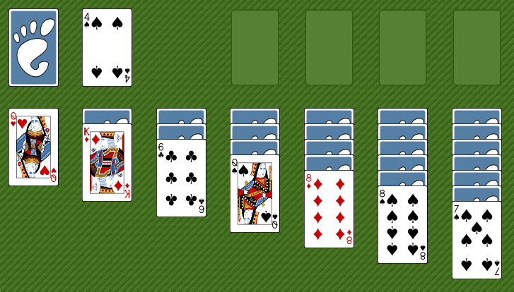
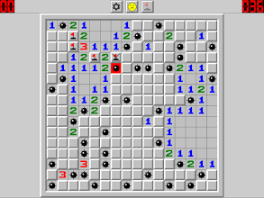
Requirement 1a
Player Format - The number, arrangement and alignment of players in a game.
Single Player: One player vs. game system
Examples include any of the Solitaire card games and the electronic game Minesweeper.

Slide 24
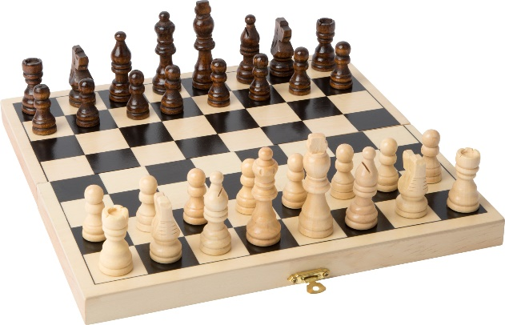
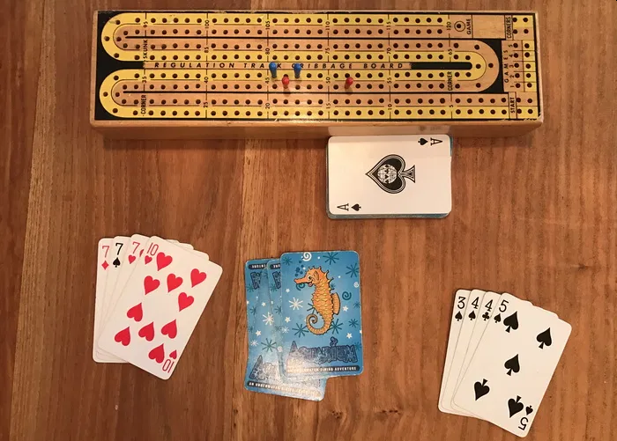
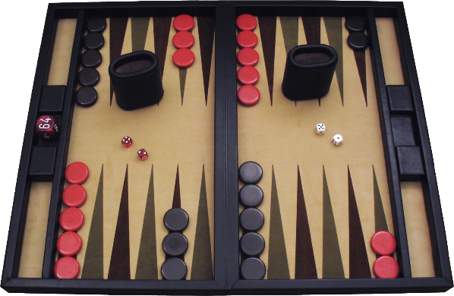
Requirement 1a
Player Format - The number, arrangement and alignment of players in a game.
Head-to-Head (one player vs. one player or PvP)
Examples include:
Chess
Cribbage
Backgammon
Tennis

Slide 25
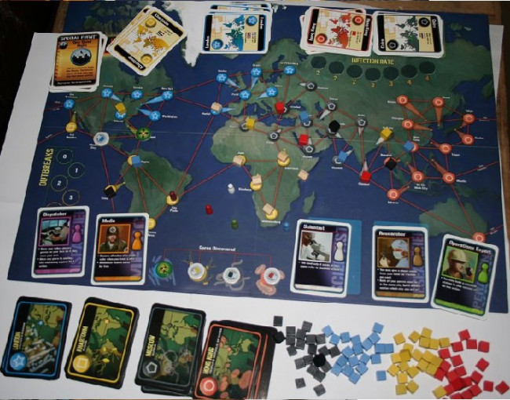
Requirement 1a
Player Format - The number, arrangement
and alignment of players in a game.
Cooperative or Player vs. Environment (PvE) (Many players vs. game system)
This is common in online games like “World of Warcraft”.
Some purely cooperative board games exist too, such as “Pandemic”.

Slide 26
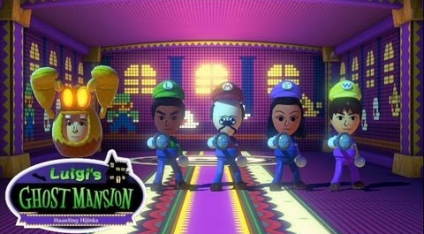
Requirement 1a
Player Format - The number, arrangement and alignment of players in a game.
One Against Many: One player vs. many players
In the Nintendo Land game “Luigi’s Ghost Mansion”, one player takes the role of a ghost trying to scare the other players while they work together to trap the ghost with their flashlights.

Slide 27
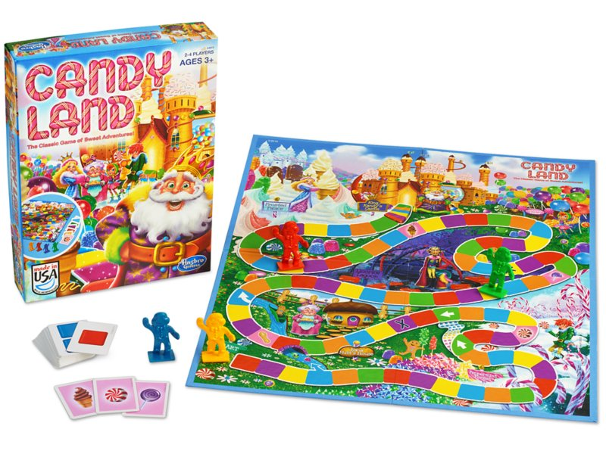
Requirement 1a
Player Format - The number, arrangement and alignment of players in a game.
Free-For-All (One player vs. one player vs. one player vs…)
Perhaps the most common player structure for multiplayer games.
This can be found everywhere, from board games like Candy Land to the basic mode in most shooter electronic games such as Halo.

Slide 28
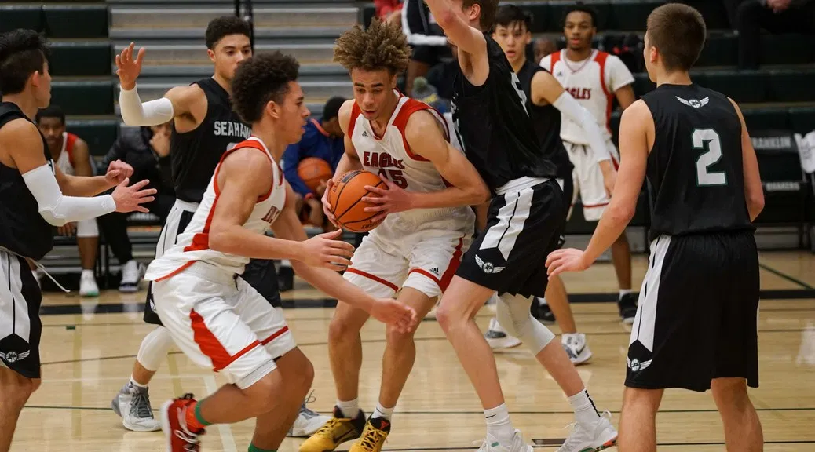
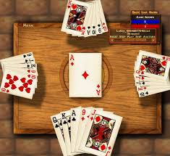
Requirement 1a
Player Format - The number, arrangement and alignment of players in a game.
Team Competition: Many players vs. many players.
This is a common structure found in most team sports, card games like euchre, and outdoor games like capture the flag.

Slide 29
Requirement 1a
Player Format - The number, arrangement and alignment of players in a game.
Predator-Prey
Players form a real or virtual circle.
Everyone’s goal is the attack the player on their left and defend themselves from the player on their right.
The live action game “Assassin” uses this structure.

Slide 30
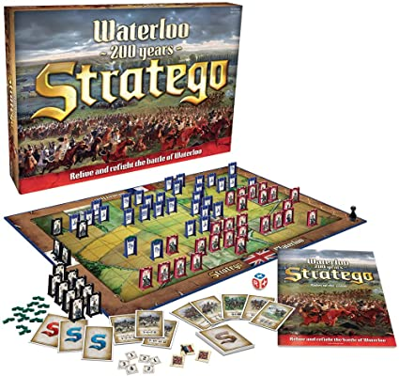
Requirement 1a
Objectives determine whether a player has advanced or won a game.
Score
Get more points than your opponent.
Be the first player to reach a particular number of points.
The game ends after a certain amount of time and the best score wins.
Capture/Destroy
Eliminate all of your opponent’s pieces from the game such as in chess and Stratego.

Slide 31
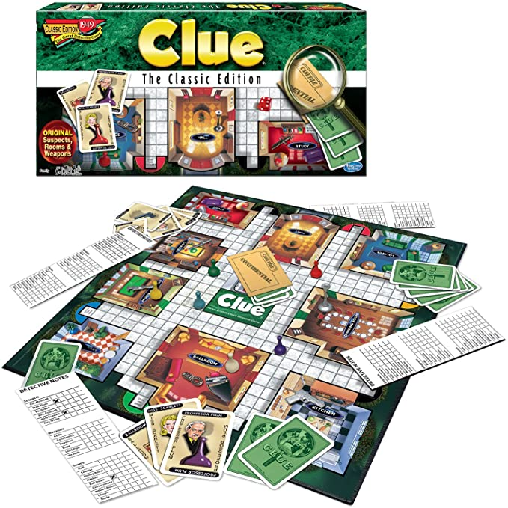
Requirement 1a
Objectives determine whether a player has advanced or won a game.
Collection
The card game rummy involves collecting sets of cards to win
Many electronic games require the player to collect a certain number of objects scattered throughout the levels.
Solve
The board game Clue is an example of a game where the objective is to solve a puzzle.

Slide 32
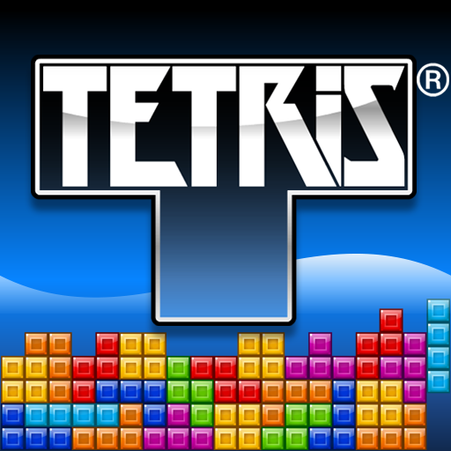
Requirement 1a
Objectives determine whether a player has advanced or won a game.
Chase/Race/Escape
Any game where you are running toward or away from something.
Candy land is a race to the finish.
Playground tag is another example.
Spatial Alignment
Games involve the positioning of elements as an objective such as tic-tac-toe or Tetris.

Slide 33
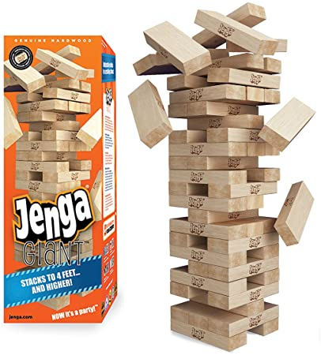
Requirement 1a
Objectives determine whether a player has advanced or won a game.
Build
Players use resources to build structures or assets such as SimCity.
Avoiding a Loss
Some games end when one player performs an act that is forbidden by the rules.
Examples include Twister and Jenga.

Slide 34
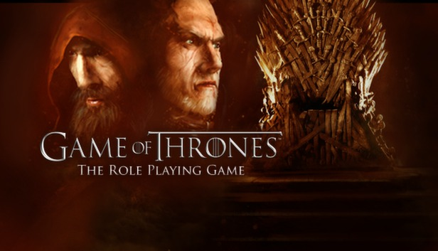
Requirement 1a
Objectives determine whether a player has advanced or won a game.
Advance the Story
Sometimes the objective of a game is just to continue a storyline and see what happens next to the characters.
This is common in role-playing games.
Explore
Game worlds like the Legend of Zelda series encourage players to travel around the world and discover new characters and places.

Slide 35
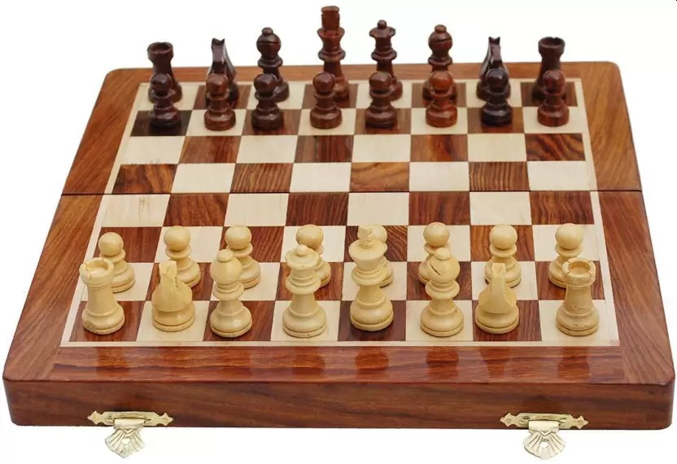
Requirement 1a
Rules
There are three categories of rules in a game.
Setup: Things you do once at the beginning of the game.
Progression of Play: What happens during the game.
Resolution: The conditions in which the game ends and how an outcome is determined.

Slide 36
Requirement 1a
Resources
Resources are all the things directly under a player’s control that can be used as the game advances.
Examples include:
Pieces in chess.
Money in Monopoly.
Territory in Risk.
Known information (the suspects you have eliminated in Clue.
Objects that can be picked up in electronic games (weapons, coins, power-ups).

Slide 37
Requirement 1a
Theme
Themes include a game’s setting, story and/or characters.
They answer the question, “What is this game about?”
Not every game has a theme, but a theme can:
Help players become more engaged.
Make a game easier to learn.
Tell a compelling story.

Slide 38
Requirement 1a
Now that you have learned about the different parts of games:
Analyze four games you have played, each from a different medium. Identify the medium, player format, objectives, rules, resources, and theme (if relevant). Discuss with your counselor the play experience, what you enjoy in each game, and what you dislike. Make a chart to compare and contrast the games.

Slide 39
Game Design Requirements
Do the following:
Analyze four games you have played, each from a different medium. Identify the medium, player format, objectives, rules, resources, and theme (if relevant). Discuss with your counselor the play experience, what you enjoy in each game, and what you dislike. Make a chart to compare and contrast the games.
Describe four types of play value and provide an example of a game built around each concept. Discuss other reasons people play games.

Slide 40
Requirement 1b
Play Value refers to the reasons that a player chooses to play a particular game.
Game experiences can be rated on 5 areas of play value:
Novelty: Imaginative, new or unexpected experiences.
Challenge: Tasks that must be practiced and mastered.
Stimulation: The emotional excitement of play.
Harmony: Player-to-player interaction.
Threat: Tension, danger, and humiliation.
Most games incorporate multiple types of play value.
Basketball involves novelty (playing against different teams), challenge (mastering skills such as shooting and dribbling), stimulation (a fast pace), harmony (cooperating with your team), and threat (playing against a good team).

Slide 41
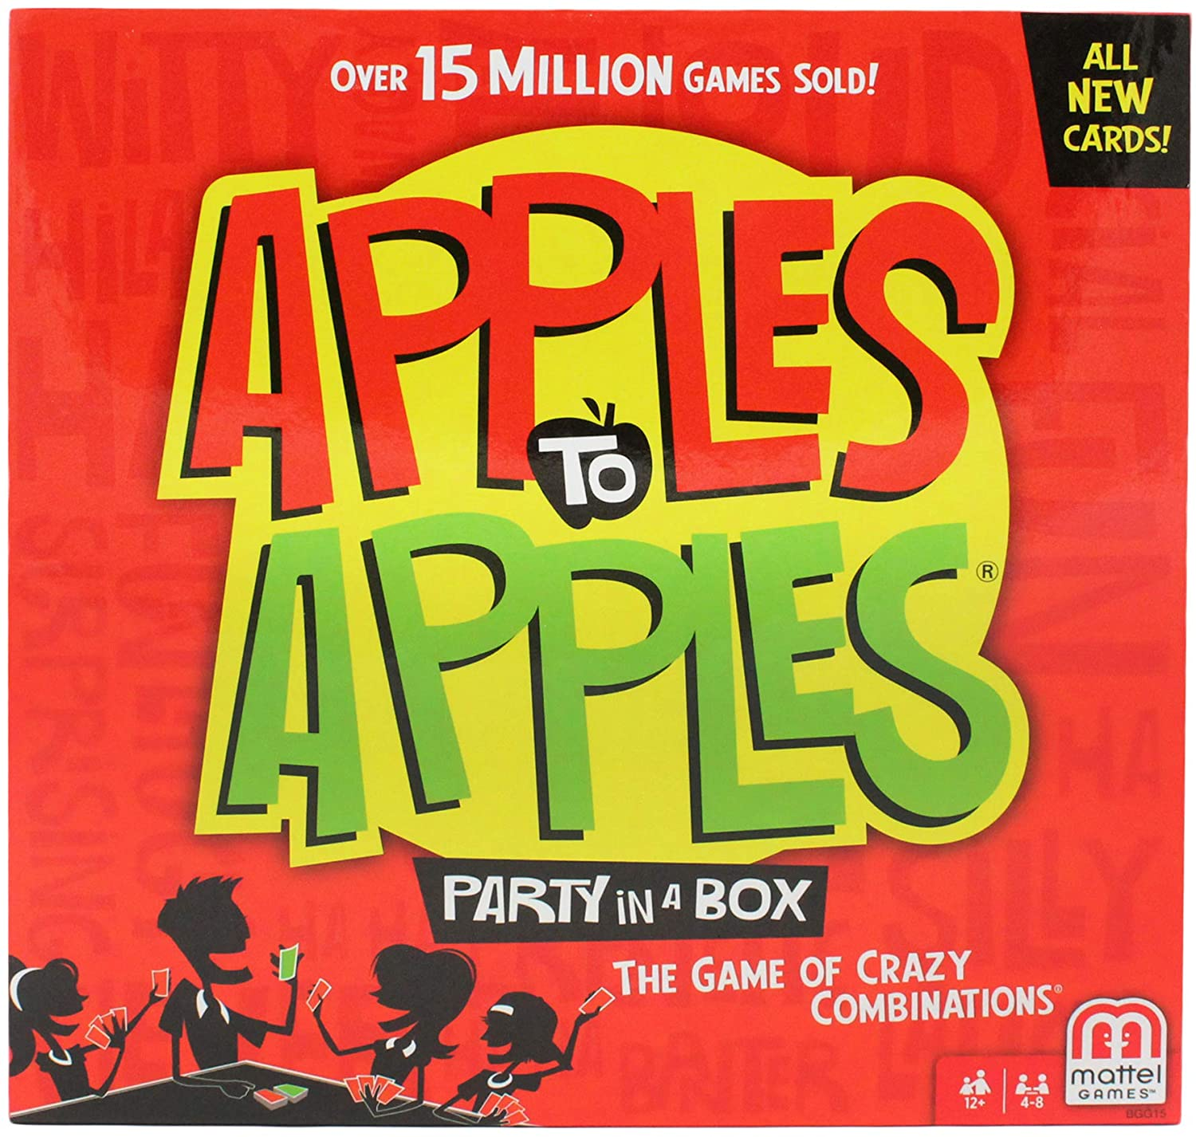
Requirement 1b
Other reasons people play games:
Help build and strengthen social ties.
Games can help start conversation.
Competition helps motivate people to practice skills and think of different ways to succeed.

Slide 42
Requirement 2
Discuss with your counselor five of the following 17 game design terms. For each term that you pick, describe how it relates to a specific game.
Thematic game elements:
story
setting
characters
Gameplay elements:
play sequence
level design
interface design
Game analysis:
difficulty
balance
depth
pace
replay value
age appropriateness
Related terms:
single-player vs. multiplayer
cooperative vs. competitive
turn-based vs. real-time
strategy vs. reflex vs. chance
abstract vs. thematic

Slide 43
Requirement 2
Thematic Game Elements
Story:
Narrative story or plot is created by the game designer.
Player created stories tell what the player did during the game.
Setting: The fictional environment in which the game takes place.
Characters: The people or creatures that appear in a game.

Slide 44
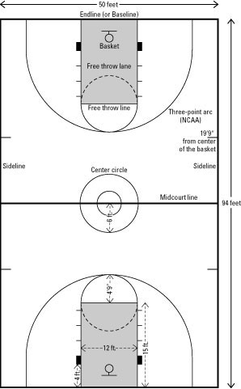
Requirement 2
Gameplay Elements
Play Sequence: The order in which players (or the game system) take action
Level Design: Creation of the game environment
The design of play space determines how and where the action occurs.
Example: 3-point line in basketball. If it is too close, players want to take every shot from behind the line. If it is too far, no one attempts 3-point shots.
The play space should also help players identify objectives and judge their progress toward the objectives.

Slide 45
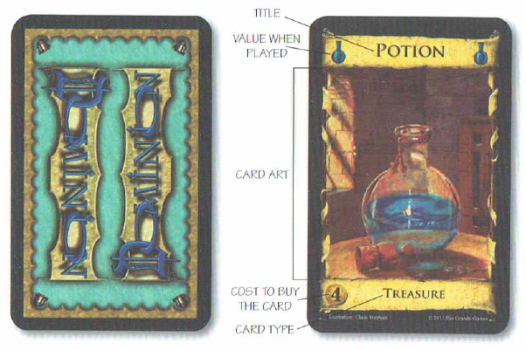
Requirement 2
Gameplay Elements
Interface Design: Creating effective methods for communicating information between players and games
Consider a deck of playing cards.
One side has some sort of design that is the same for all cards so they can be randomly mixed and their values hidden.
The other side has symbols, colors, and numbers to communicate information to players.
Electronic games use screens and button layouts.
Rule sheets, glossaries, tutorials, and help sections are also parts of the interface.

Slide 46
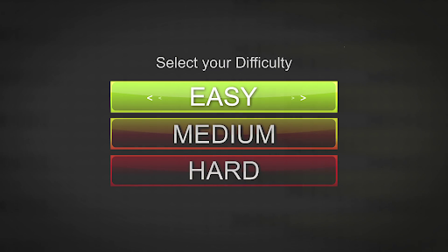
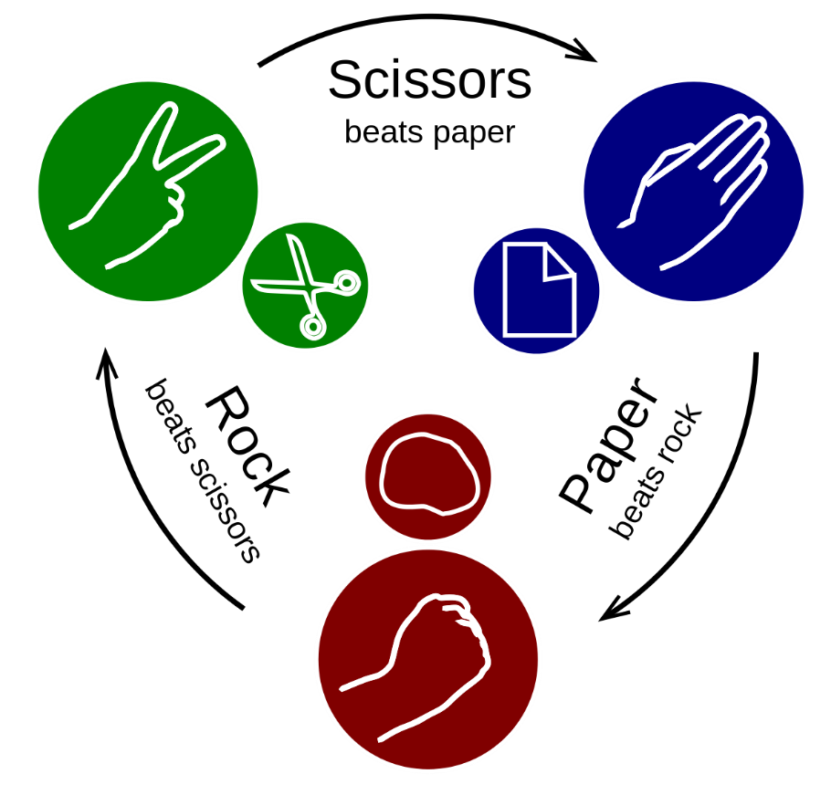
Requirement 2
Game Analysis
Difficulty: How easy or hard it is for a player to complete the game objectives.
Balance: The relative strength of the different resources, mechanics, objectives, or starting states.
A balanced game does not give an unequal advantage or disadvantage to any player (rock-paper-scissors game)
If a player can choose between two different paths, but one is always better, then the choice is not balanced.

Slide 47
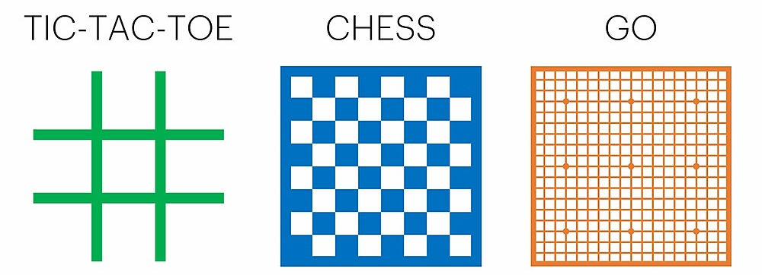
Requirement 2
Game Analysis
Complexity: The number of rules or elements with which a player interacts.
The greater the complexity, the harder it is to learn how to play the game.
Depth: The ability to find enjoyment in a game as one’s skill improves.
Chess is a game that gets great depth from modest complexity

Slide 48
Requirement 2
Game Analysis
Pace: The speed of the game (chess vs. basketball).
Play Value: The reason someone plays a game.
Replay Value: The reason someone plays a game over and over again.
Age Appropriateness: The age or maturity level of the game’s intended audience.

Slide 49
Requirement 2
Related Terms
Single-player vs. multiplayer: One player vs. more than one player.
Cooperative vs. competitive:
Cooperative games require players to work together to achieve objectives while competitive games have winners and losers.
Many team games are both cooperative and competitive.

Slide 50
Requirement 2
Related Terms
Turn-based vs. real-time:
Turn-based allows one player or team to control the play and then switching control to the next player or team.
Simultaneous play means that more than one player or team can act at the same time.
In a real-time game, all players act at the same time throughout the game.
Turn-Based vs. Real Time
Chess | Baseball | Capture the Flag
Players alternate turns | Teams switch between offense and defense | Players are always on both offense and defense
While one player plays, the other waits | After each pitch, play finishes before the next pitch begins | Flags are reset only when a point is scored
 | During a play, players from both teams participate | Action happens continuously

Slide 51
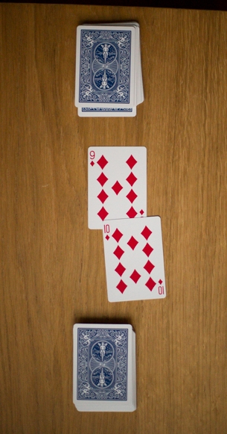
Requirement 2
Related Terms
War
Strategy vs. reflex vs. chance
Strategic (mental) and reflex (physical) gameplay are different expressions of player skill.
In both cases, the player has control over the outcome through decisions and actions.
Chance-based mechanics have a randomized outcome.
Chance adds uncertainty to make a game more exciting.
Decisions lose meaning if the outcomes are decided solely by dice rolls or card shuffles such as in the War card game.

Slide 52
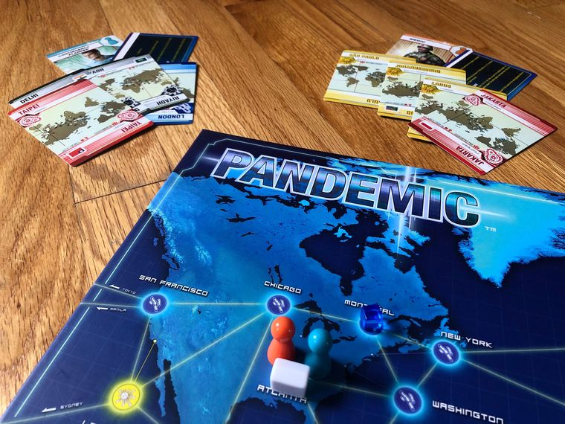
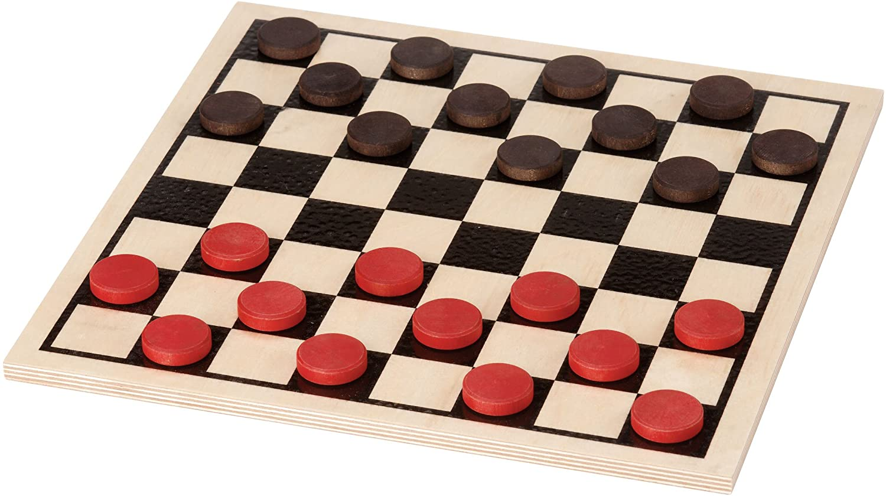
Requirement 2
Related Terms
Abstract vs. thematic
While many games are thematic (as discussed earlier), some are abstract, meaning that they don’t incorporate nongame information into the game.
Examples of abstract games are: checkers, most playing card games, dominoes, golf, and Tetris.

Slide 53
Requirement 3
Define the term intellectual property. Describe the types of intellectual property associated with the game design industry. Describe how intellectual property is protected and why protection is necessary. Define and give an example of a licensed property.

Slide 54
Requirement 3
Intellectual Property is the creations of the mind for which the creator has exclusive rights.
For a game, this would be:
Computer Code
Visual Displays
Story
Characters
Music
Voice Recordings
Game Board
Game Pieces
Instruction Manual
Game Title
Packaging
Company Logo

Slide 55
Requirement 3
Intellectual Property is protected by:
Copyright: The right to make copies of creative, literary or artistic works noted by a ©.
Trademark: Ownership of a word, phrase or symbol representing the goods or services of a company noted by a ™.
Patent: Ownership of an invention or method of doing something.
Licensing: A contract between you and a rights owner to use those rights for a fee.
An example would be using a movie such as Star Wars for a game theme.
The purpose of intellectual property rights is to allow the owner to commercialize or develop for sale their invention without others stealing their ideas and profiting off of them.

Slide 56
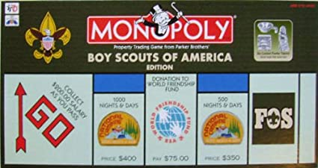
Requirement 3
Intellectual Properties
How might copyrights, trademarks, patents and licensing be used in this game of Boy Scouts of America Monopoly?

Slide 57
Requirement 4
Do the following:
Pick a game where the players can change the rules or objectives (examples: basketball, hearts, chess, kickball). Briefly summarize the standard rules and objectives and play through the game normally.
Propose changes to several rules or objectives. Predict how each change will affect gameplay.
Play the game with one rule or objective change, observing how the players’ actions and emotional experiences are affected by the rule change. Repeat this process with two other changes.
Explain to your counselor how the changes affected the actions and experience of the players. Discuss the accuracy of your predictions.

Slide 58
Requirement 5
Design a new game. Any game medium or combination of mediums is acceptable. Record your work in a game design notebook.
Write a vision statement for your game. Identify the medium, player format, objectives, and theme of the game. If suitable, describe the setting, story, and characters.
Describe the play value.
Make a preliminary list of the rules of the game. Define the resources.
Draw the game elements.

Slide 59
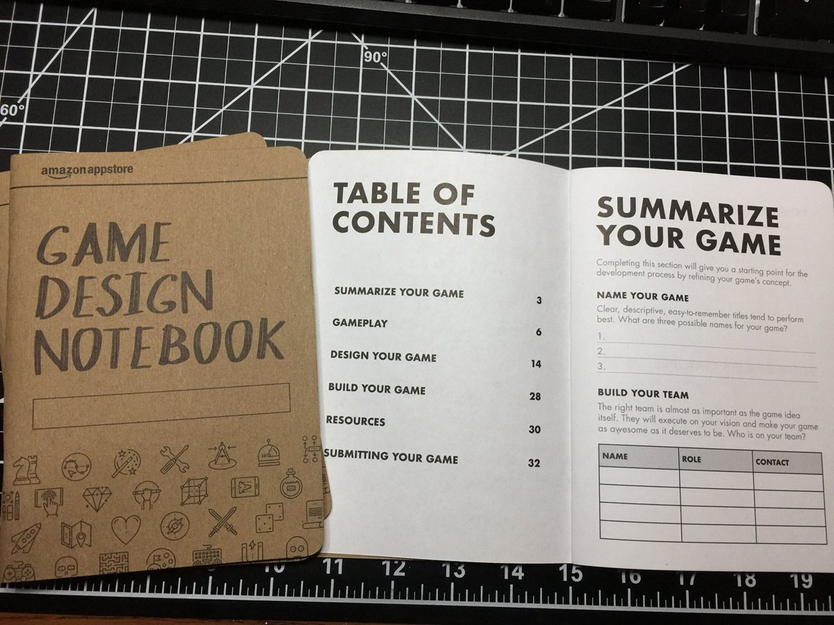
Requirement 5a
Starting Your Game
Design Notebook
Introduction: Describes what you are aiming for in your game in 3 brief sections.
Vision statement: Describe your game in a sentence or two.
Limitations: The game will have limitations, depending on the medium and the equipment needed to play the game.
Timeline: Set progress goals with specific time milestones so that the project can be completed in a reasonable time.

Slide 60
Requirement 5a
Game Design Notebook
Main Text - Brainstorming
Brainstorming is the process of coming up with as many ideas as possible to solve a problem or accomplish a task.
Think about what your game could be.
Write down every idea in your notebook.
Do not worry about the details at this time.
Take the player on an adventure.
Teach a skill.
Simulate another activity, like ruling an empire or flying a plane.
Explore themes or settings, like space travel or pizza delivery.

Slide 61
Requirement 5a
Game Design Notebook
Main Text - Organize Your Ideas
Read through your ideas and put a star next to all of the ones that catch your attention.
Ask yourself and then write your answers in your notebook:
What makes those ideas fascinating?
What would the game look like?
Pick out the which one seems most interesting.
Add details to your idea so you can begin to see your game more clearly.
Use game elements to guide this process.

Slide 62
Requirement 5a
Game Design Notebook
Main Text - Players vs. Designers
Game designers and game players look at games very differently.
Designers are focused on how the game works.
Game players want the enjoyment and challenge of playing a game as well as the fun of spending time with friends.
While developing and testing your game, you will switch back and forth between designer and player.
As a designer, you will think of something to add to your game.
As a player, you will give the idea a try to see what you think about it.
Record everything in your notebook.

Slide 63
Requirement 5a, 5b, 5c, 5d
Game Design Notebook
Main Text – Game Format
Identify and record the game medium, player format, objectives, and theme of the game.
If appropriate, describe the setting, story, and characters.
Describe the play value.
List the rules of the game.
Define the resources needed for the game.
Draw the game elements.

Slide 64
Requirement 6
Do the following:
Prototype your game from requirement 5. If applicable, demonstrate to your counselor that you have addressed player safety through the rules and equipment. Record your work in your game design notebook.
Test your prototype with as many other people as you need to meet the player format. Compare the play experience to your descriptions from requirement 5b. Correct unclear rules, holes in the rules, dead ends, and obvious rule exploits. Change at least one rule, mechanic, or objective from your first version of the game, and describe why you are making the change. Play the game again. Record in your game design notebook whether or not your change had the expected effect.
Repeat 6b at least two more times and record the results in your game design notebook.

Slide 65
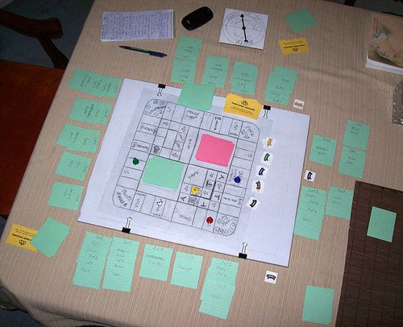
Requirement 6
Prototype Your Game
You must have your merit badge counselor’s approval of your concept before you begin creating your prototype!
Build a version of your game.
Test it.
Adjust it.
Repeat the process until your game is engaging and satisfying.
When designing a physical game or sport it is essential to consider safety.
The rules and mechanics should enforce safe play.
Protective equipment should be used to reduce risk.

Slide 66
Requirement 6
Prototype Your Game
Test your prototype with as many other people as you need to meet the player format.
Compare the player experience to your descriptions.
Correct unclear rules, holes in the rules, dead ends, and obvious rule exploits.
Change at least one rule, mechanic, or objective from your first version of the game, and describe why you are making the change.
Play the game again.
Record whether or not your change had the expected effect.
Repeat at least two more times and record your results.

Slide 67
Requirement 7
Blind test your game. Do the following:
Write an instruction sheet that includes all of the information needed to play the game. Clearly describe how to set up the game, play the game, and end the game. List the game objectives.
Share your prototype from requirement 6a with a group of players that has not played it or witnessed a previous playtest. Provide them with your instruction sheet(s) and any physical components. Watch them play the game, but do not provide them with instruction. Record their feedback in your game design notebook.
Share your game design notebook with your counselor. Discuss the player reactions to your project and what you learned about the game design process. Based on your testing, determine what you like most about your game and suggest one or more changes.

Slide 68
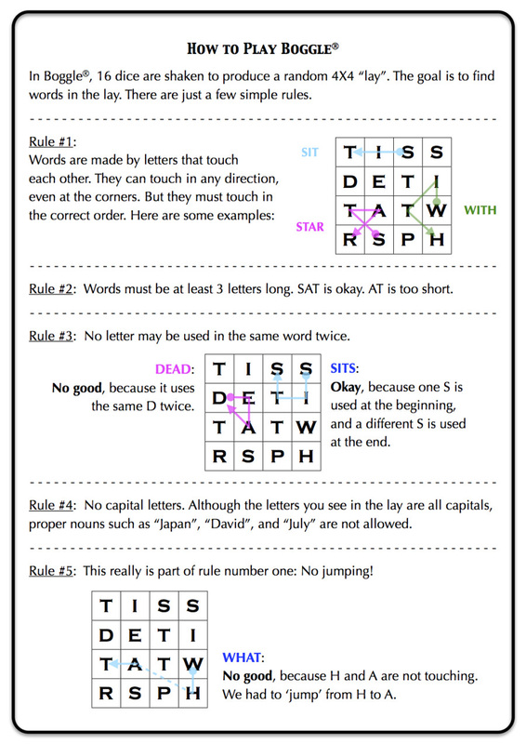
Requirement 7a
Writing Rules for Your Game
Write the rules for your game.
Test your ruleset by having someone unfamiliar with your game explain your game to you after reading your rules.
Give examples for special or complicated situations.

Slide 69
Requirement 7
Blind test your game. Do the following:
Write an instruction sheet that includes all of the information needed to play the game. Clearly describe how to set up the game, play the game, and end the game. List the game objectives.
Share your prototype from requirement 6a with a group of players that has not played it or witnessed a previous playtest. Provide them with your instruction sheet(s) and any physical components. Watch them play the game, but do not provide them with instruction. Record their feedback in your game design notebook.
Share your game design notebook with your counselor. Discuss the player reactions to your project and what you learned about the game design process. Based on your testing, determine what you like most about your game and suggest one or more changes.

Slide 70
Requirement 7b
Blind Test Your Game
In a blind test the players have no experience with the game and do not interact with the designer during the test.
They use the rules and components provided by the designer and play the game as well as they are able.
The game designer observes and takes notes to identify problems for correction.
After the game is over, ask the players about the game experience.
Find out what aspects of the game were confusing, boring, or too difficult.
Modify your game if necessary based upon player feedback.

Slide 71
Requirement 7
Blind test your game. Do the following:
Write an instruction sheet that includes all of the information needed to play the game. Clearly describe how to set up the game, play the game, and end the game. List the game objectives.
Share your prototype from requirement 6a with a group of players that has not played it or witnessed a previous playtest. Provide them with your instruction sheet(s) and any physical components. Watch them play the game, but do not provide them with instruction. Record their feedback in your game design notebook.
Share your game design notebook with your counselor. Discuss the player reactions to your project and what you learned about the game design process. Based on your testing, determine what you like most about your game and suggest one or more changes.

Slide 72
Requirement 8
Do ONE of the following:
With your parent’s permission and your counselor’s approval, visit with a professional in the game development industry and ask him or her about his or her job and how it fits into the overall development process. Alternately, meet with a professional in game development education and discuss the skills he or she emphasizes in the classroom.
List three career opportunities in game development. Pick one and find out about the education, training, and experience required for the profession. Discuss this with your counselor. Explain why this profession might interest you.

Slide 73
Requirement 7b
Careers in Game Development
Video Game Designer and related occupations are among the fastest growing careers in America.
Video Game Designer
A college degree or certificate in game design or creative writing will help you get hired as a video game designer. Skills to look for in a video game designer education program include game theory, storytelling and storyboarding, game planning and strategy, creative content writing, brainstorming and creative thinking, and game design project management.
Video Game Programmer
For game design programming jobs, the education requirement is typically a bachelor's degree in video game development, computer science, software engineering, mobile application development, game and simulation programming, or a similar programming-focused area of study.

Slide 74
Requirement 7b
Careers in Game Development
Video Game Artist
Education requirements for game art jobs ideally include a specialized 2- or 4-year game art degree, however a traditional art school degree is acceptable in many cases. Video game artists must first master traditional art techniques and principles, such as form, perspective and color theory, before they can apply these skills to game elements like characters and environments. A prospective video game artist's most crucial asset is his or her design portfolio; the stronger and more relevant your portfolio, the less you will have to rely on your formal education to land the job. The ability to effectively use modern graphic design and computer animation software, such as Adobe Flash, will also help you get hired as a video game artist.

